Slide 1
Creating a Narrative Budget Telling the story of your ministry
Paul Sales
Financial Development Officer, Quebec and Eastern Ontario
psales@united-church.ca 613-841-9291
Notes:
This PowerPoint presentation is meant to be accompanied by the following resources:
Handouts:
Presentation in handout format
Orleans United Church sample
Tips & Enrichments
Biblical References
Stewardship Quotations
Giving Tables and Giving Ladder
Links to resources including samples
Workshop Evaluation
Worksheets
Ministry Area Checklist
Ministry Diary

Slide 2
Agenda
Definition
Examples
Benefits
Putting It Together
Going Forward
Questions
Notes:
Introduction:
Refreshments
Set up – in the round if possible
Logistics – screen, projector, etc.

Slide 3
Definition

Slide 4
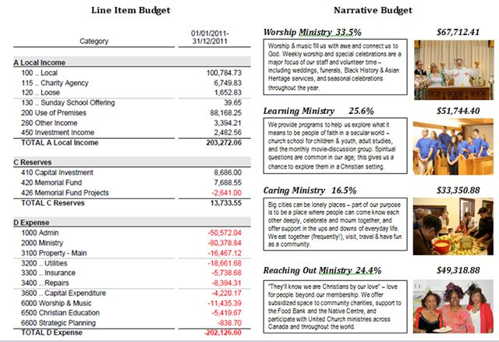
Notes:
What does the budget mean?
Yes, it is the financial situation of the congregation, however, it is also much more.
Where your treasure is, there your heart will be also.
The budget describes what we value most.

Slide 5
A Narrative Budget …
Tells the sacred story of the congregation:
Integrates vision, people and all resources
Transforms dollar figures into the story of mission and ministry
Focuses on the ‘investment’ being made as the United Church in the community
Communicates how we further the mission of God’s church
Notes:
ALL RESOURCES - money, building, infrastructure, programming

Slide 6
A Narrative Budget …
Is a stewardship/ministry document
Is NOT an accounting document
Supplements – does NOT replace – financial statements

Slide 7
A Narrative Budget …
Emphasizes the results of offerings and donations – not the expenditures
Recognizes that
“You do not give money to the church; you give money through the church to translate the church’s vision into action”*
* The Reverend David Ponting

Slide 8
Two Examples
Notes:
http://orleansunitedchurch.com/blog/2012/02/09/narrative-budget/
Handout with financial detail.

Slide 9
Orleans United Church
Ministry | Investment | Per $100
Worship Ministry | $92,500 | $ 21 of every $100 donated
Learning Ministry | $88,500 | $ 20 of every $100 donated
Care Ministry | $68.500 | $ 18 of every $100 donated
Outreach Ministry | $79,000 | $ 19 of every $100 donated
Resource Ministry | $105,500 | $ 22 of every $100 donated
All Ministry | $454,000
Notes:
Hand out OUC Stewardship letter.
Using a dollar figure out of a hundred aligns an individual’s gift with a ministry more effectively than x cents out of a dollar.

Slide 10
St. James United Church
St James United Church
St James United Church
A Caring Community Sharing Faith
MISSION STATEMENT:
We faithfully respond to God’s love by encouraging others to know Christ, through worship, service,
education and prayer.
Notes:
Hand out copies.
Using a dollar figure out of a hundred aligns an individual’s gift with a ministry more effectively than x cents out of a dollar.

Slide 11
Benefits
Notes:
Why bother?
It is a best practice that has been proven to create much greater interest in supporting the mission of the congregation.
Process of reflection; builds intentionality in giving

Slide 12
Benefits
1. Communicates complex financial information for a broader audience

Slide 13
Benefits
2. Links vision, values and ministry with financial priorities

Slide 14
Benefits
3. Helps develop a deeper understanding of stewardship
Articulates how funds for management (stewardship) of the building (heating and lights) enable ministry

Slide 15
Benefits
4. Inspires members in their giving as they see how their generous gifts
Make a difference
Change lives

Slide 16
Benefits
5. Knowing the impact on need, members are more likely to:
Discuss those needs more deeply
Tell others about the work of the congregation
See their own stewardship as an expression of their faith

Slide 17
Putting it Together
Notes:
Structure is the way in which the information is summarized; the categories of ministry in your congregation using language that aligns with their experience.
There are various ways that congregations have ‘organized’ their ministry …

Slide 18
1. Identify Your Ministry Areas
Segregate your ministry into categories that link back to
A New Creed and/or
Your Mission
Notes:
Getting the structure right is important.
And ask yourselves,
How do we live out, or deliver on, this mission?
What are the major activities things that we do?
Can we group these activities?
Ask, “What about administration?”
ADMINISTRATION is an element to support all of the ministry that happens

Slide 19
Examples:
Worship
Christian Development
Pastoral Care
Outreach & Community Presence (including Mission and Service)
Notes:
Getting the structure right is important.
ADMINISTRATION is an element to support all of the ministry that happens

Slide 20
2. Budget & Time Allocations
Review line item budget, group items into the identified ministry areas.
Create a spreadsheet with ministry areas.
Ask all staff and lay leaders to allocate their time for a two-week period.
Notes:
Some things will slide evenly into specific ministry areas.
Other things will be divided between ministry areas (e.g., Administration, office expenses) Salaries: Allocate salaries based on the percentages established HAND OUT BLANK CHART/WORKSHEET?

Slide 21
Budget Allocation
4. Pro-rate all operational costs to ministry areas.
5. Examine building usage for past year to allocate costs to ministry areas.
Notes:
Allocate salaries based on the percentages established

Slide 22
Time & Talent Allocation
Track the gift of time
Volunteer hours and their impact
Notes:
Allocate salaries based on the percentages established

Slide 23
Budget & Time Allocations
Remember:
Only broad accuracy within categories is important.
The story is the focus.
Numbers are a key supporting player.

Slide 24
3. Create the Narrative
For each ministry area:
1. Tell the story.
2. Quantify results.
Programs in place; People served
3. Use anecdotes / quotes / testimonials / scripture
Notes:
Handout

Slide 25
Create the Narrative
5. Include photographs
With people, whenever possible – with permission
Avoid empty buildings)
6. Use visuals – pie charts, etc.
Notes:
Handout

Slide 26
4. Use It!
INTERNALLY
In the annual report – along with financial statements
Highlight ministries – one a month; one a week building up to AGM; prepare bulletin insert on each ministry area
Board Meeting agenda – use the topic areas to drive the meeting agenda
Notes:
It now has many more applications in the life of the congregation
Use your imagination!

Slide 27
Use It!
Part of a new member package
Create a children’s edition of the narrative budget
Planning tool and evaluation:
Are we happy with the focus of our mission?
What is the theology of this budget?
Is our vision supported by our budget?
Notes:
It now has many more applications in the life of the congregation
Use your imagination!

Slide 28
Use It!
EXTERNALLY
On website; blogs; social media
Grant applications
Outreach with the wider community
Tell your congregation’s story
Emphasize United Church positions and actions in social justice, equity and the environment.
Notes:
“Silent” United Church people
People who would be Tell the Story!

Slide 29
Going Forward
First year involves the most work. Keep records!
Each year you improve it.
Look for resources at:
www.stewardshiptoolkit.ca

